Slide 1
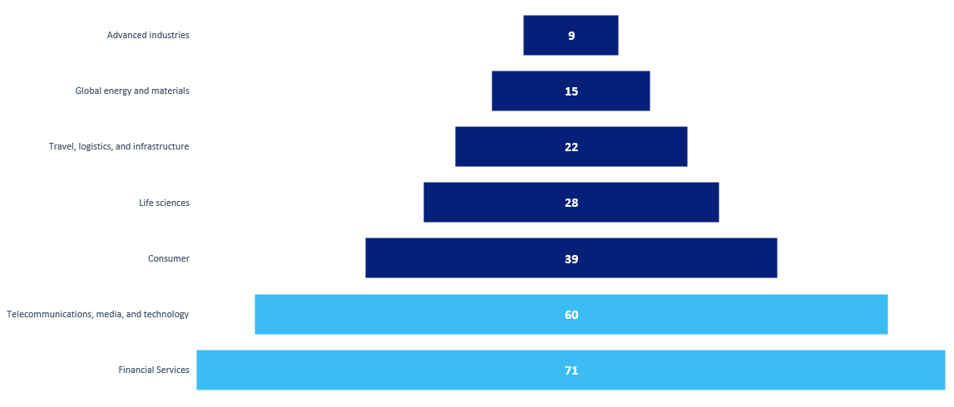
Technology enabled up to 71 percent of the value derived in business transformations across different sectors.
Business transformation impact dependent on technology, %

Slide 2
Following a sharp decline in 2020, M&A activity in the machinery sector
surpassed prepandemic levels in 2021 and 2022.
Source: Capital IO; McKinsey analysis

Slide 3
At every step up the corporate ladder, Women of color lose ground to White women and Men of color.
Representation by corporate role, by gender and race, 2021, % of employees
White Women
Women of Color
Men of Color
White Men
Note: Figures may not sum to 100%, because of rounding.
Source: Women in the Workplace 2021, Leanln.Org and McKinsey, 2021

